Slide 1


Psychotherapy treatment selection

Slide 2

An audio recording of a therapy session is created

Slide 3


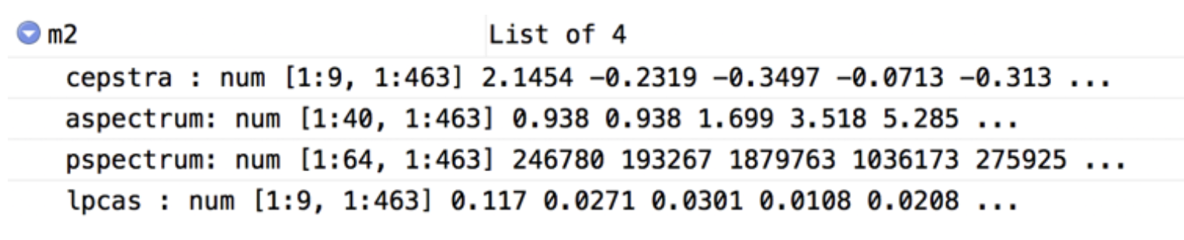

0:00 / 0:30
The recording is transformed into a data format that may be analysed using computer software
Features of the speech data are anaysed to derive a feedback report for therapist
Feedback report

Slide 4
Feedback report
Therapist
M. Peter
Client
A. Miller
Global ratings
advanced: 4.0
Session strengths
Excellent use of reflections.
3.60
basic: 3.5
3.49
Areas for improvement
You could ask more open questions.
Overall competence
Empathy
Behavior counts
Reflection to question ratio: 92
Percent open questions: 48
Notes:
Add information about training dataset (how were recommendations derived?)
- the recommentation (e.g., level of empathy) were derived by comparing the recordings to therapy sessions that were identified as optimal

Slide 5

The feedback may be used for training and skill improvement

